Slide 1


M.Tech Program
Advanced Industry Integrated Programs
Jointly offered by University and LTIMindTree
Customer Churn Prediction & Retention System
Team Member
Bhavyam Ramani
Knowledge partner | Implementation partner

Slide 2
Project Title - Calibri body 18
Problem Statement
Customer churn = loss of clients / subscribers.
Business lose 5-25 times more in acquiring new customers Vs retaining old ones.
Traditional Classification misses timing and actionable insights.
High churn causes revenue loss, need to predict WHEN and WHY customers leave, not just WHO leaves.
Existing churn models often only give Yes / No churn outputs.
Business lack actionable insights to retain customers.

Slide 3
Project Title - Calibri body 18
Project Objectives
Predict churn probability (Yes/No) using ML classification models.
Predict time-to-churn using survival analysis.
Identify Top-5 churn reasons per customer with feature attribution.
Estimate Customer Lifetime Value (CLV) from survival probabilities.
Provide personalized retention recommendations.
Enable customer segmentation.
Build an interactive UI for churn risk, reasons, and retention strategies.
Ensure scalable, reproducible deployment with MLOps.

Slide 4
Project Title - Calibri body 18
Scope of Work
Collect and preprocess customer churn dataset (Telco).
Perform EDA and Feature Engineering to identify churn patterns.
Train ML classification models (Logistic Regression, Random Forest, XGBoost) for churn Yes/No prediction.
Implement survival models (Kaplan-Meier, Cox PH, DeepSurv) for time-to-churn prediction.
Generate personalized churn explanations (Top-5 reasons per customer using SHAP).
Perform customer segmentation with clustering based on survival curves.
Design retention strategies aligned with churn reasons.
Deploy system with MLOps (DVC, MLflow, Docker, CI/CD, Monitoring).

Slide 5
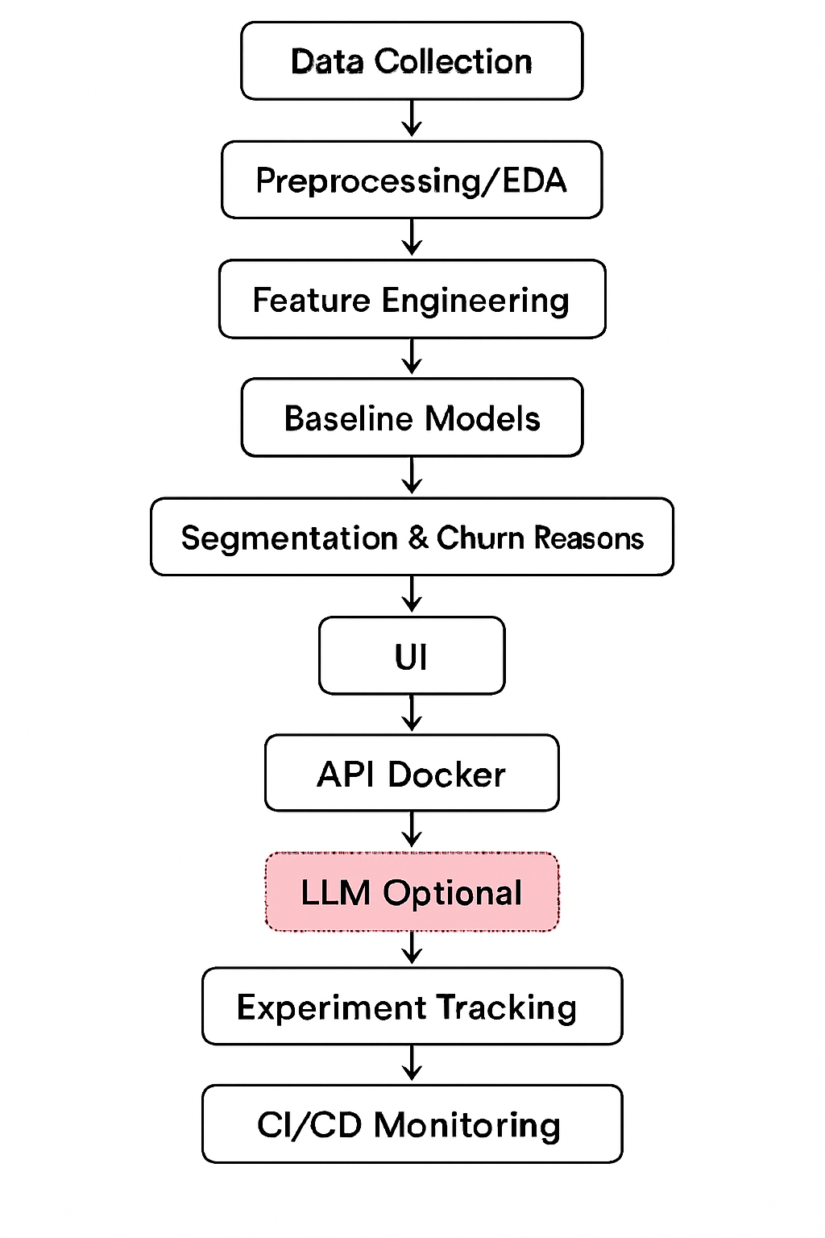
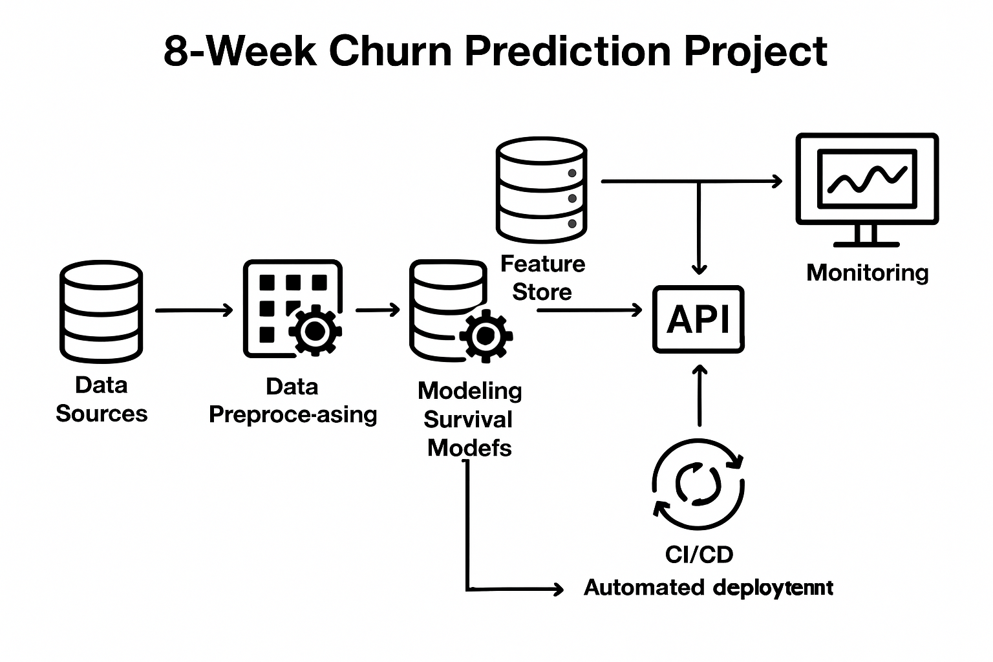
Project Title - Calibri body 18
Architecture Diagram

Slide 6
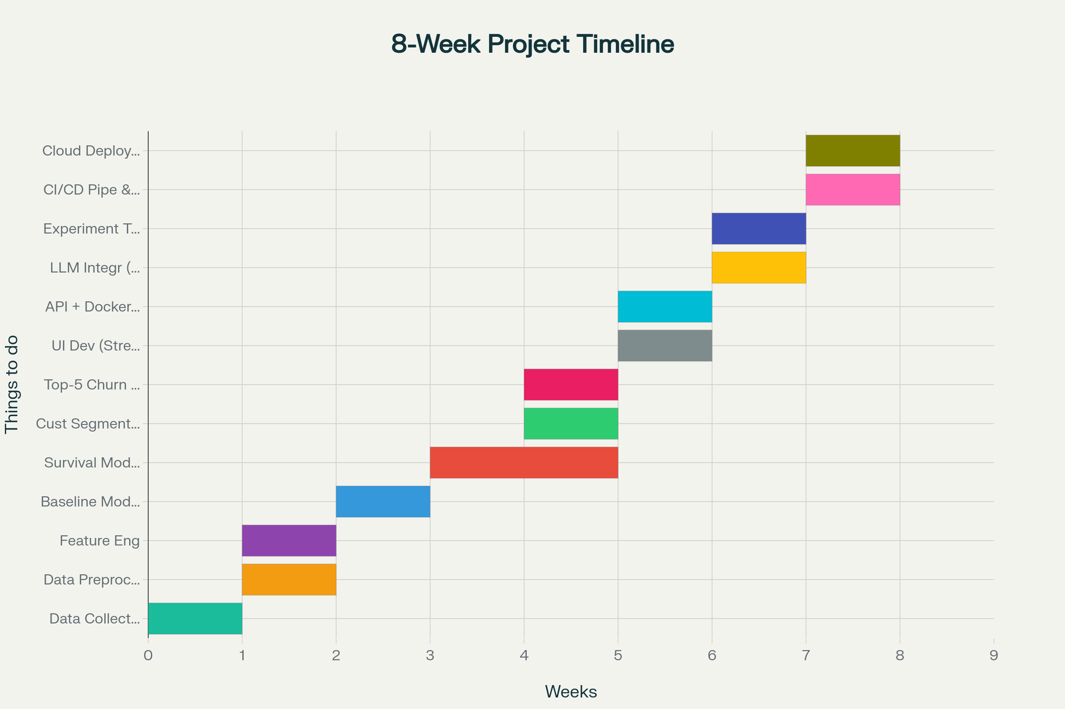

Slide 7
Project Timeline And Tasks
Week 1: Data Collection, Requirement Analysis & Versioning Setup (DVC/MLflow)
Week 2: Data Preprocessing, EDA & Feature Engineering
Week 3: BASELINE MODELS + Kaplan-Meier + Cox Proportional Hazards Implementation
Week 4: DeepSurv Implementation & Hyperparameter Tuning
Week 7: Experiment Tracking (MLflow/W&B) + Model Registry Setup
Week 5: Top 5 Churn Reasons, Customer Segmentation & Retention Strategy
Week 6: UI Development (Streamlit) + API (FastAPI/Flask) + Dockerization
Week 8: CI/CD Integration, Cloud Deployment, Monitoring & Final Report

Slide 8
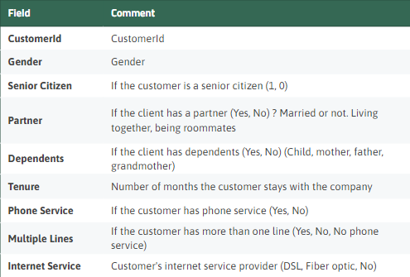
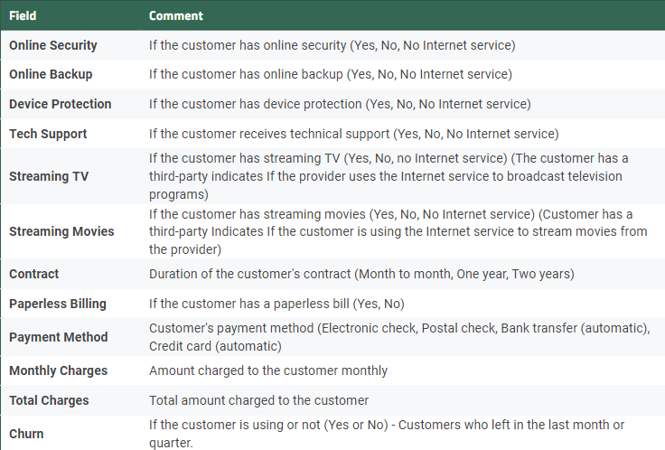
Project Title - Calibri body 18
Dataset

Slide 9
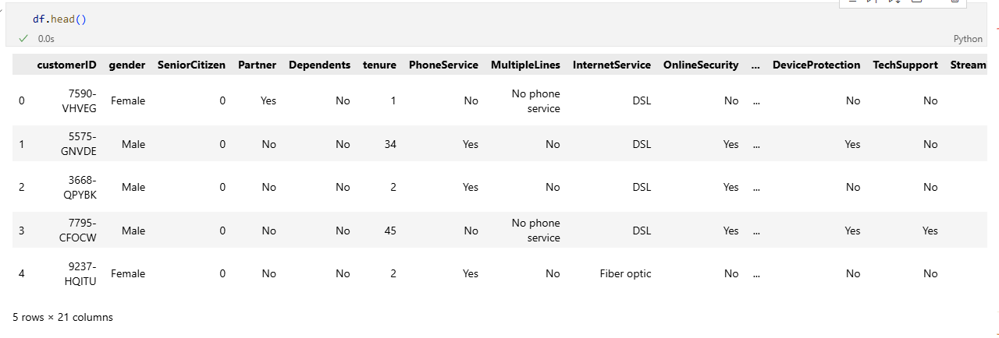
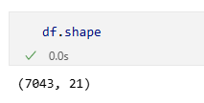
Project Title - Calibri body 18

Slide 10
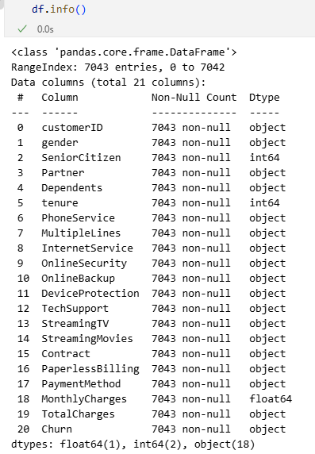
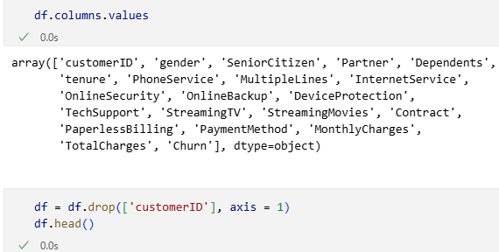

Slide 11
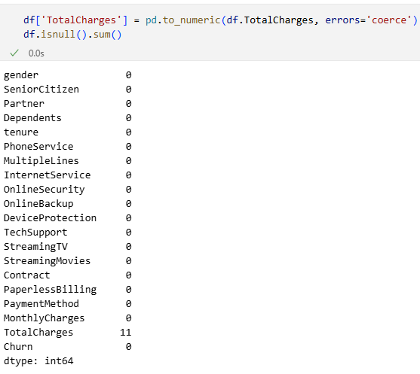
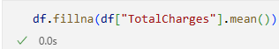
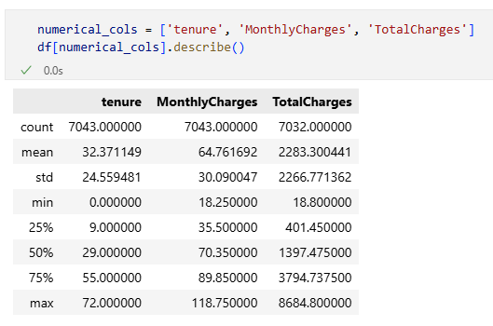

Slide 12
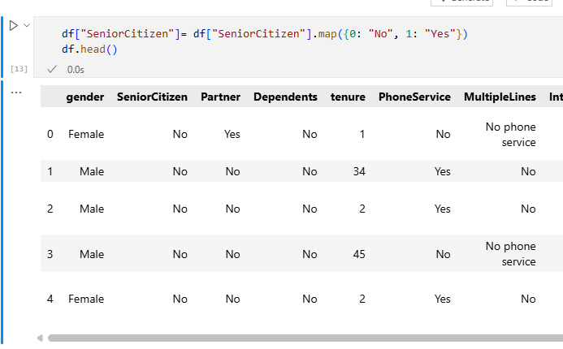

Slide 13
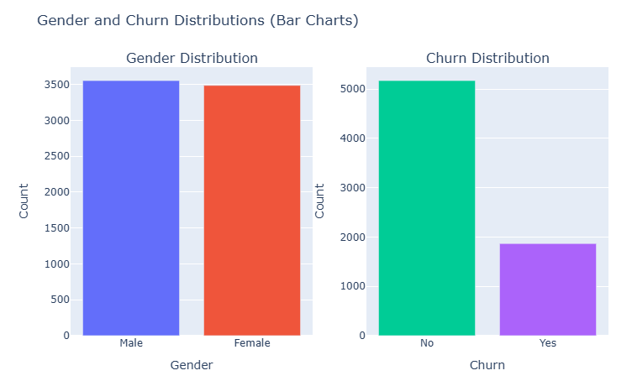
Churn Distribution based on Gender: There is almost no difference in the number or percentage of customers who switched their service provider based on gender. Both men and women behaved in the same way when it comes to migrating to another service provider.

Slide 14
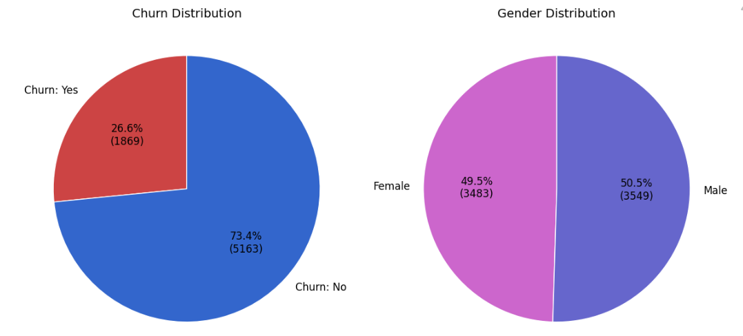

Slide 15
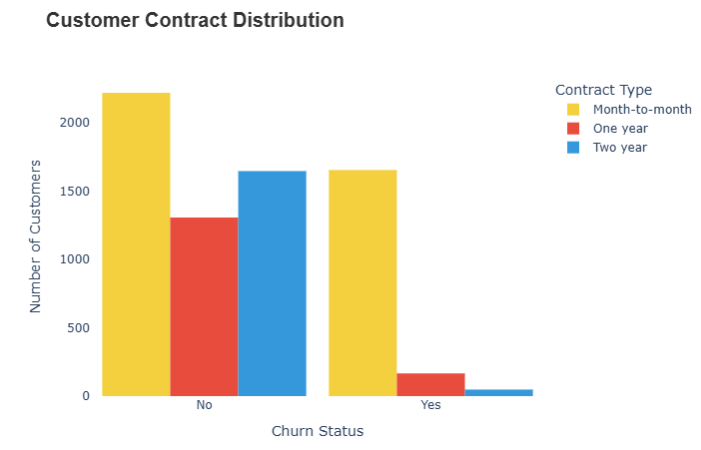
About 75% of customers with Month-to-Month contract opted to move out as compared to 13% of customers with One Year Contract and 3% with Two Year Contract.

Slide 16
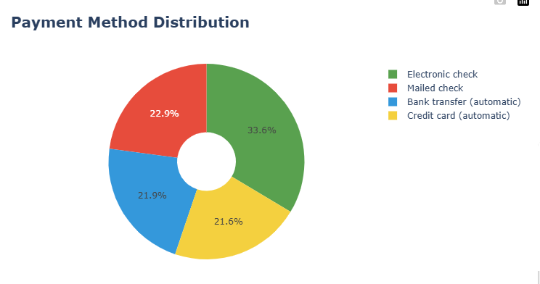
33.6% customers prefer payment method as Electronic Check.
22.9% customers prefer payment method as Mailed Check.
21.9% customers prefer payment method as Bank transfer (automatic).
21.6% customers prefer payment method as Credit Card (automatic).

Slide 17
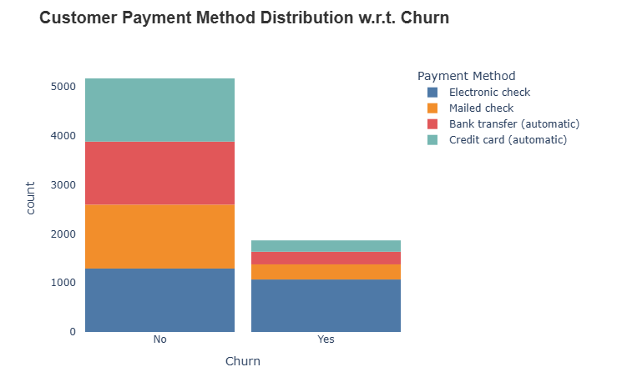
Customer Payment Method Distribution with respect to Churn: Major customers who switched to another service were having Electronic Check as Payment method.
Customers who opted for Credit card automatic transfer or Bank Automatic transfer and Mailed check as Payment method were less likely to move out.

Slide 18
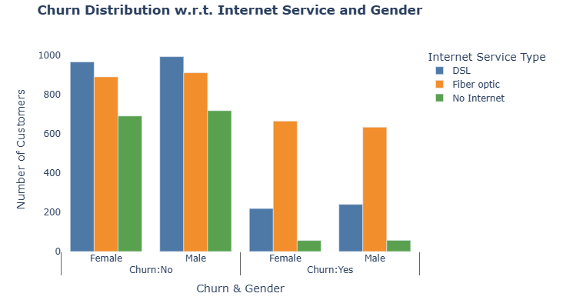
A lot of customers choose the Fiber Optic service and it’s also evident that the customers who use Fiber Optic have high churn rate, this might suggest a dissatisfaction with this type of internet service.
Customers having DSL service are majority in number and have less churn rate compared to Fibre optic service.

Slide 19
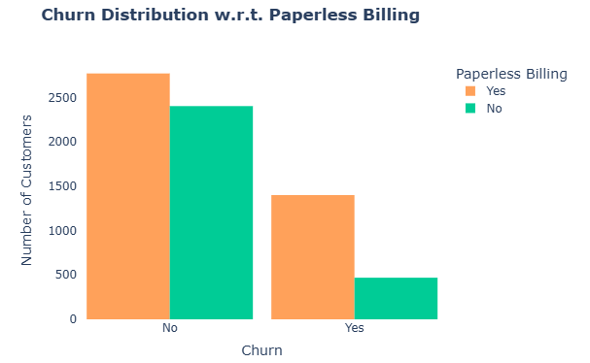
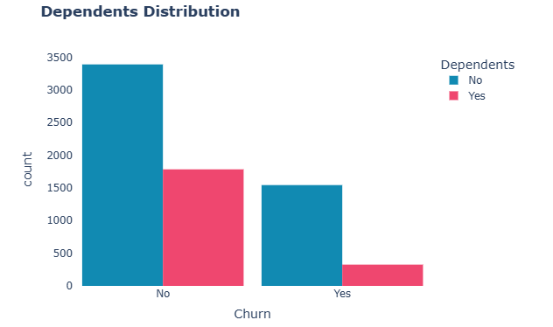
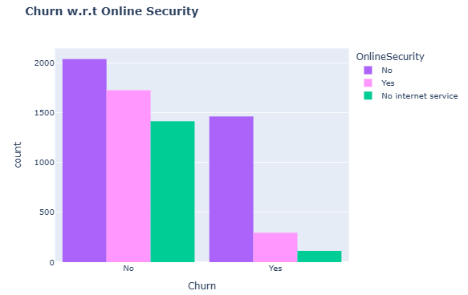
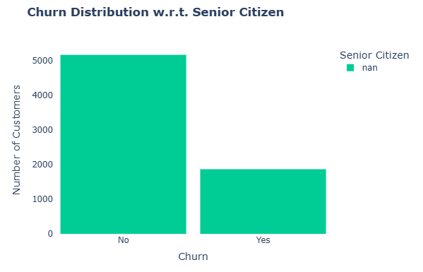
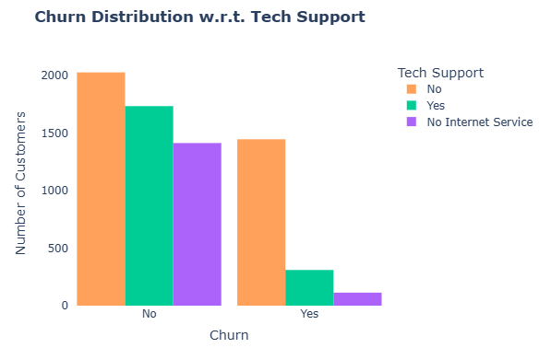
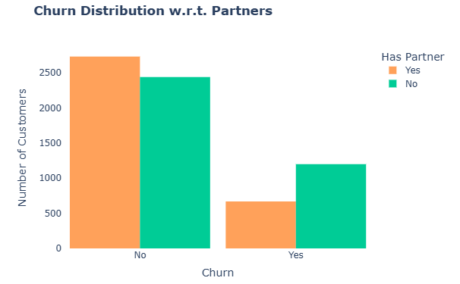

Slide 20
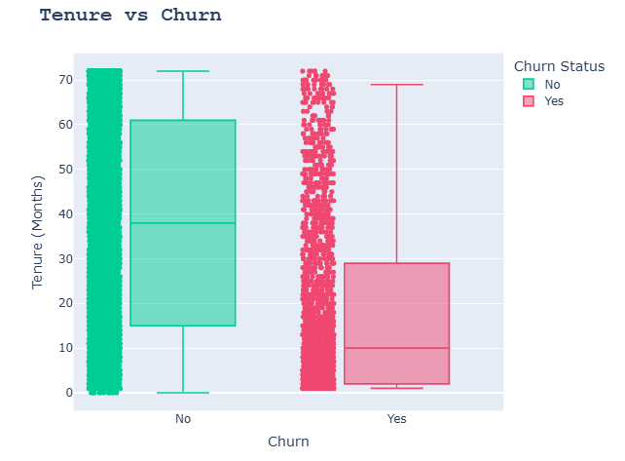
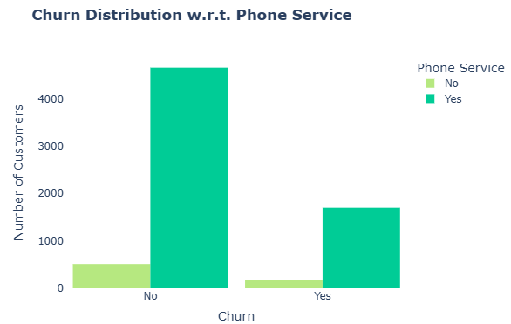
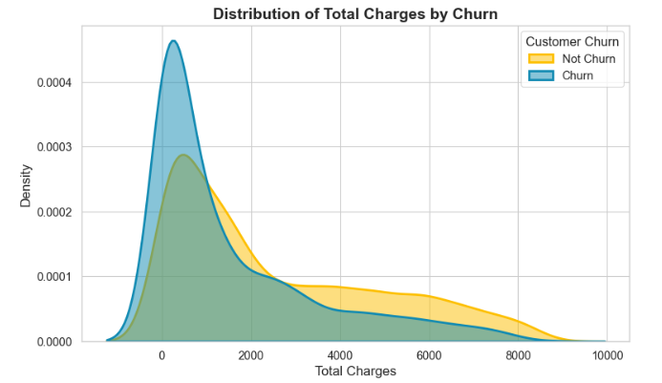
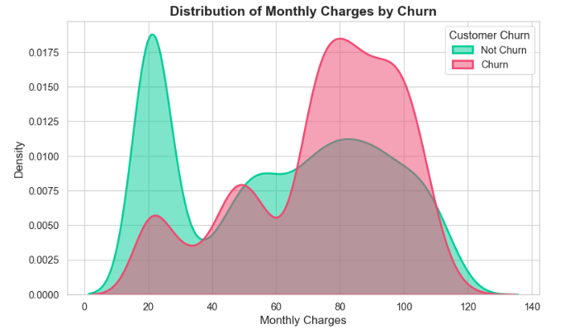
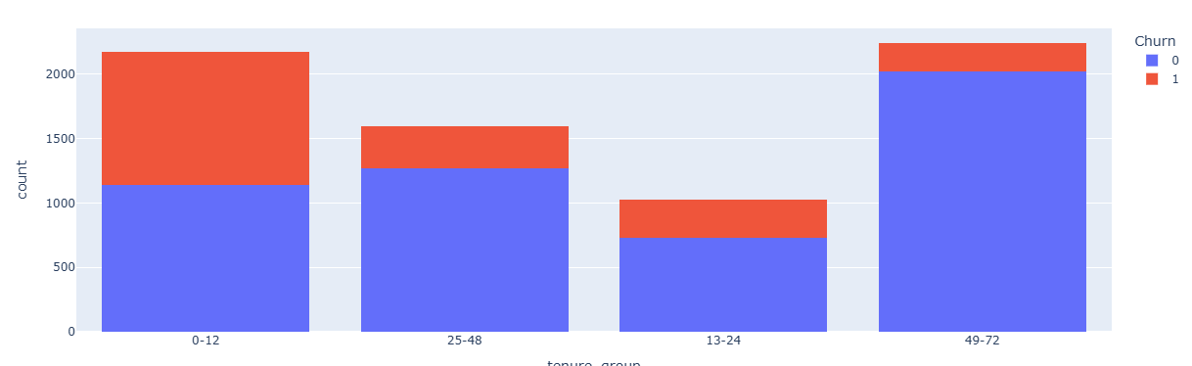

Slide 21
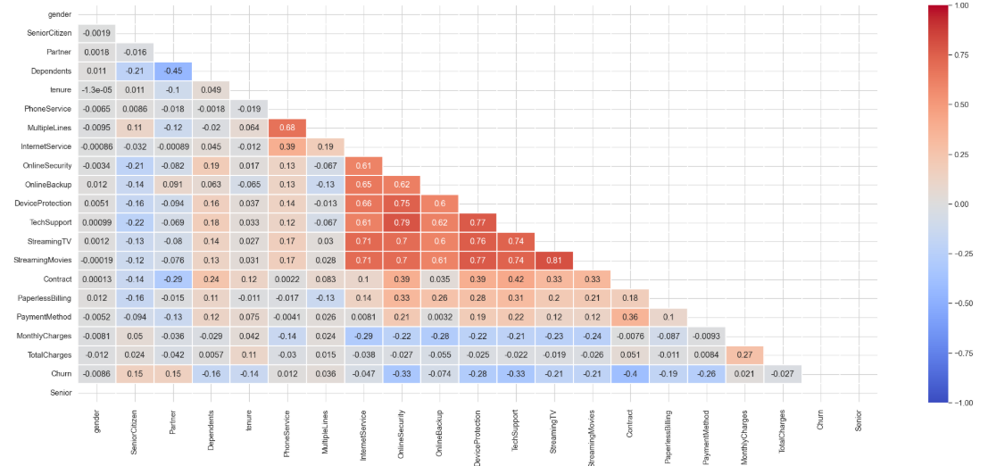

Slide 22
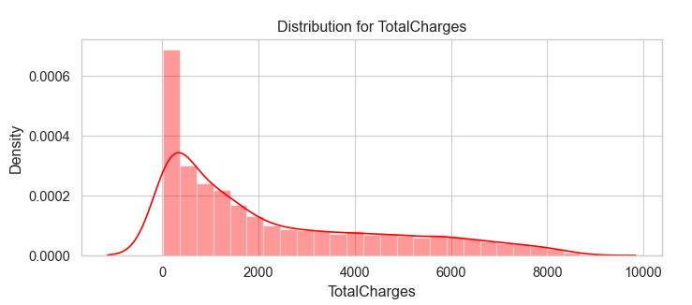
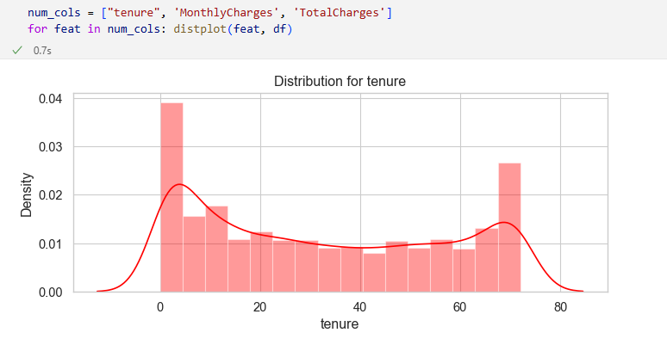
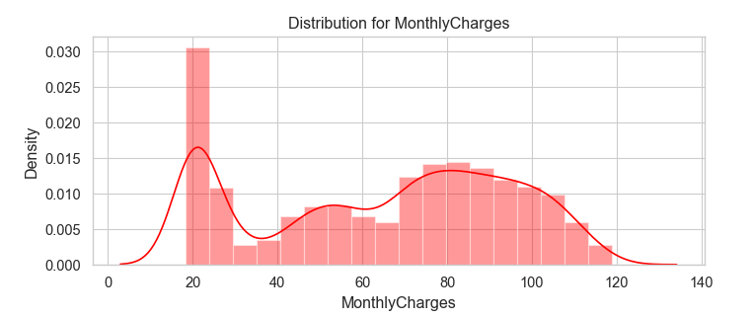
Used Standard Scalar to scale them down to the same range, since the numerical features are distributed over different value ranges
Used train_test_split to split to the data into train and test sets

Slide 23
Project Title - Calibri body 18
Literature Review
Paper 1: DeepSurv – Personalized Treatment Recommender System
Objective: Introduces DeepSurv, a deep neural network extension of the Cox proportional hazards model for survival analysis and personalized treatment recommendations.
Key Concepts:
Traditional Cox model assumes linearity → limits predictive power for complex data.
DeepSurv uses nonlinear modeling with neural networks to capture complex interactions.
Methodology:
Deep feed-forward neural network trained using Cox partial likelihood.
Incorporates treatment as a categorical variable to recommend personalized options.
Findings:
Outperforms traditional Cox and Random Survival Forest (RSF) in predictive accuracy.
Provides personalized treatment recommendations that can improve survival time.

Slide 24
Project Title - Calibri body 18
Literature Review
Significance: Demonstrates the potential of deep learning in medical survival analysis and treatment personalization.
Paper 2: Survival-Based Predictive Analytics for Customer Churn
Objective: Compares Cox regression, Cox-Time, and Deephit for predicting customer churn in a streaming company.
Key Concepts:
Survival analysis applied to customer churn prediction.
Evaluates models on different sample sizes to test scalability and performance.
Methodology:
Metrics: Concordance Index (C-index) and Integrated Brier Score (IBS).

Slide 25
Project Title - Calibri body 18
Literature Review
Models:
Cox regression: Semi-parametric, interpretable, efficient for small datasets.
Cox-Time: Neural network extension, handles non-proportional hazards.
Deephit: Discrete-time deep learning model, strong for large datasets.
Findings:
Small sample: Cox regression performs best.
Large sample: Deephit outperforms others (C-index = 0.905, IBS = 0.033).
Significance: Neural network models excel with large data; Cox remains relevant for small datasets.

Slide 26
Project Title - Calibri body 18
Summary of Literature Review
Both studies highlight the evolution of survival analysis from traditional Cox models to advanced deep learning approaches.
Common theme: Deep learning models (DeepSurv, Deephit) improve predictive accuracy and handle complex, nonlinear relationships.
Differences:
Paper 1 focuses on medical treatment personalization.
Paper 2 applies survival analysis to business/customer analytics.
Key Insight: Model choice depends on data size and complexity:
Small datasets → Cox regression is efficient and interpretable.
Large datasets → Neural network models (DeepSurv, Deephit) provide superior performance.
Practical Implication: Deep learning enhances predictive analytics across domains, but computational cost and interpretability remain challenges.

Slide 27
Project Title - Calibri body 18
Industry Insights
Netflix, Spotify & Disney+ are known to use survival analysis(Deephit & Cox-Time) and ML models use for churn prediction.
Roche, Pfizer, and Novartis have explored DeepSurv-like models for personalized treatment recommendations and clinical trial survival modeling. Used to predict patient outcomes, optimize treatment paths, and stratify risk in oncology and cardiology.
AXA and Swiss Re have applied survival models to policyholder retention, claim prediction, and lifetime value modeling.
Allkenso reduced churn by 50% through ML models that track user behavior and automate retention campaigns
LUT University found Random Forest to be the most effective model in a comparative study.

Slide 28
Project Title - Calibri body 18
Tools & Technologies
Category Programming AI / ML Visualization Experiment Tracking Web Interface (UI) Deployment | Tools / Tech Stack Python, Jupyter Notebook, FastAPI, Streamlit Scikit‑learn; XGBoost; LightGBM,Logistic Regression (Kaplan–Meier, Cox PH), PySurvival; PyTorch (DeepSurv) Matplotlib, Seaborn, Plotly, SHAP, PowerBI MLflow / Weights & Biases Streamlit (frontend); FastAPI (backend API) Docker, GitHub Actions (CI/CD), AWS / GCP / Azure Cloud

Slide 29
Project Title - Calibri body 18
References
Katzman et al., 'DeepSurv' (BMC Med Res Methodol, 2018): Deep neural net extension of Cox PH for personalized risk. (Use for DeepSurv methodology)
Singh, 'Survival-based predictive analytics for customer churn' (2024 thesis): Evaluates classical and neural survival models for churn prediction (useful comparison & evaluation metrics).
Additional resources: Databricks survival analysis accelerator; ACM paper on deep survival analysis for churn.
Industry sources: Netflix, AXA, Swiss Re, Allkenso, Pfizer
Data Source: https://www.kaggle.com/datasets/blastchar/telco-customer-churn

Slide 30
THANKYOU

